Slide 1
Graph IV

Slide 2
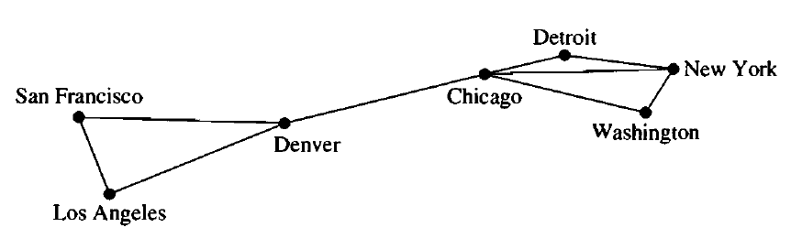
Connected Graph
Is this graph connected?
Yes. We can reach any vertex from any other vertex in this graph

Slide 3
Connected Graph
Is this graph connected?
We cannot reach LA from NY
So the graph is not connected

Slide 4
Connected Components
We can communicate between LA, SF and Denver
We can communicate between Detroit, NY, Chicago and Washington
These are connected components

Slide 5
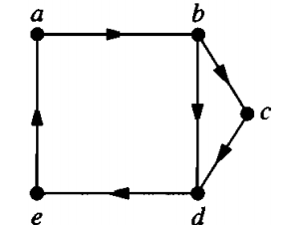
Strongly Connected Graph
Let us consider the following directed graph
We can reach to any vertex from any other vertex in this graph
This graph is a strongly connected graph

Slide 6
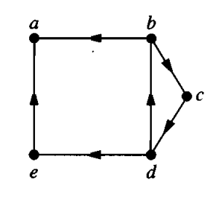
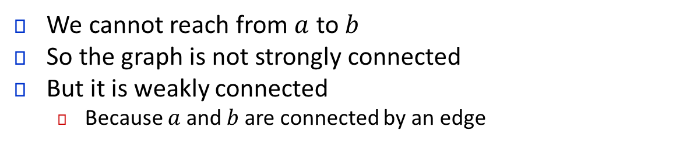
Strongly Connected Graph
We cannot reach from $a$ to $b$
So the graph is not strongly connected
But it is weakly connected
Because $a$ and $b$ are connected by an edge

Slide 7
Weakly Connected Graph
We say a directed graph is weakly connected if its underlying undirected graph is connected
Imagine rickshaws going to the wrong side :P

Slide 8
Algorithm (Procedure) for finding the Strongly Connected Components
Step 1:
Provide a token to a vertex.
The vertex will be marked with a discovery time.
Then the vertex will pass the token to its adjacent vertices (all of them, one by one).
The process will be repeated for all the vertices that receives the token.
When a vertex cannot pass a token any further it will return back the token.
While returning back it will be marked with a closure time
1
4
5
2
3
6
7

Slide 9
Algorithm (Procedure) for finding the Strongly Connected Components
Step 1:
Provide a token to a vertex.
The vertex will be marked with a discovery time.
Then the vertex will pass the token to its adjacent vertices (all of them, one by one).
The process will be repeated for all the vertices that receives the token.
When a vertex cannot pass a token any further it will return back the token.
While returning back it will be marked with a closure time
Token
1
4
5
2
3
6
7

Slide 10
Algorithm (Procedure) for finding the Strongly Connected Components
Step 1:
Provide a token to a vertex.
The vertex will be marked with a discovery time.
Then the vertex will pass the token to its adjacent vertices (all of them, one by one).
The process will be repeated for all the vertices that receives the token.
When a vertex cannot pass a token any further it will return back the token.
While returning back it will be marked with a closure time
Token
1
4
5
1|
2
3
6
7

Slide 11
Algorithm (Procedure) for finding the Strongly Connected Components
Step 1:
Provide a token to a vertex.
The vertex will be marked with a discovery time.
Then the vertex will pass the token to its adjacent vertices (all of them, one by one).
The process will be repeated for all the vertices that receives the token.
When a vertex cannot pass a token any further it will return back the token.
While returning back it will be marked with a closure time
1
4
5
1|
Token
2
3
6
7

Slide 12
Algorithm (Procedure) for finding the Strongly Connected Components
Step 1:
Provide a token to a vertex.
The vertex will be marked with a discovery time.
Then the vertex will pass the token to its adjacent vertices (all of them, one by one).
The process will be repeated for all the vertices that receives the token.
When a vertex cannot pass a token any further it will return back the token.
While returning back it will be marked with a closure time
1
4
5
1|
Token
2
3
6
7
2|

Slide 13
Algorithm (Procedure) for finding the Strongly Connected Components
Step 1:
Provide a token to a vertex.
The vertex will be marked with a discovery time.
Then the vertex will pass the token to its adjacent vertices (all of them, one by one).
The process will be repeated for all the vertices that receives the token.
When a vertex cannot pass a token any further it will return back the token.
While returning back it will be marked with a closure time
1
4
5
1|
Token
2
3
6
7
2|

Slide 14
Algorithm (Procedure) for finding the Strongly Connected Components
Step 1:
Provide a token to a vertex.
The vertex will be marked with a discovery time.
Then the vertex will pass the token to its adjacent vertices (all of them, one by one).
The process will be repeated for all the vertices that receives the token.
When a vertex cannot pass a token any further it will return back the token.
While returning back it will be marked with a closure time
1
4
5
1|
2
3
6
7
2|
Token

Slide 15
Algorithm (Procedure) for finding the Strongly Connected Components
Step 1:
Provide a token to a vertex.
The vertex will be marked with a discovery time.
Then the vertex will pass the token to its adjacent vertices (all of them, one by one).
The process will be repeated for all the vertices that receives the token.
When a vertex cannot pass a token any further it will return back the token.
While returning back it will be marked with a closure time
1
4
5
1|
2
3
6
7
3|
2|
Token

Slide 16
Algorithm (Procedure) for finding the Strongly Connected Components
Step 1:
Provide a token to a vertex.
The vertex will be marked with a discovery time.
Then the vertex will pass the token to its adjacent vertices (all of them, one by one).
The process will be repeated for all the vertices that receives the token.
When a vertex cannot pass a token any further it will return back the token.
While returning back it will be marked with a closure time
Token
1
4
5
1|
2
3
6
7
3|
2|

Slide 17
Algorithm (Procedure) for finding the Strongly Connected Components
Step 1:
Provide a token to a vertex.
The vertex will be marked with a discovery time.
Then the vertex will pass the token to its adjacent vertices (all of them, one by one).
The process will be repeated for all the vertices that receives the token.
When a vertex cannot pass a token any further it will return back the token.
While returning back it will be marked with a closure time
Token
1
4
5
1|
4|
2
3
6
7
3|
2|

Slide 18
Algorithm (Procedure) for finding the Strongly Connected Components
Step 1:
Provide a token to a vertex.
The vertex will be marked with a discovery time.
Then the vertex will pass the token to its adjacent vertices (all of them, one by one).
The process will be repeated for all the vertices that receives the token.
When a vertex cannot pass a token any further it will return back the token.
While returning back it will be marked with a closure time
Token
1
4
5
1|
4|
2
3
6
7
3|
2|

Slide 19
Algorithm (Procedure) for finding the Strongly Connected Components
Step 1:
Provide a token to a vertex.
The vertex will be marked with a discovery time.
Then the vertex will pass the token to its adjacent vertices (all of them, one by one).
The process will be repeated for all the vertices that receives the token.
When a vertex cannot pass a token any further it will return back the token.
While returning back it will be marked with a closure time
Token
1
4
5
1|
4|
5|
2
3
6
7
3|
2|

Slide 20
Algorithm (Procedure) for finding the Strongly Connected Components
Step 1:
Provide a token to a vertex.
The vertex will be marked with a discovery time.
Then the vertex will pass the token to its adjacent vertices (all of them, one by one).
The process will be repeated for all the vertices that receives the token.
When a vertex cannot pass a token any further it will return back the token.
While returning back it will be marked with a closure time
1
4
5
1|
4|
5|
2
3
6
7
3|
2|
Token

Slide 21
Algorithm (Procedure) for finding the Strongly Connected Components
Step 1:
Provide a token to a vertex.
The vertex will be marked with a discovery time.
Then the vertex will pass the token to its adjacent vertices (all of them, one by one).
The process will be repeated for all the vertices that receives the token.
When a vertex cannot pass a token any further it will return back the token.
While returning back it will be marked with a closure time
1
4
5
1|
4|
5|
2
3
6
6|
7
3|
2|
Token

Slide 22
Algorithm (Procedure) for finding the Strongly Connected Components
Step 1:
Provide a token to a vertex.
The vertex will be marked with a discovery time.
Then the vertex will pass the token to its adjacent vertices (all of them, one by one).
The process will be repeated for all the vertices that receives the token.
When a vertex cannot pass a token any further it will return back the token.
While returning back it will be marked with a closure time
1
4
5
1|
4|
5|
2
3
6
6|
7
3|
2|
Token

Slide 23
Algorithm (Procedure) for finding the Strongly Connected Components
Step 1:
Provide a token to a vertex.
The vertex will be marked with a discovery time.
Then the vertex will pass the token to its adjacent vertices (all of them, one by one).
The process will be repeated for all the vertices that receives the token.
When a vertex cannot pass a token any further it will return back the token.
While returning back it will be marked with a closure time
1
4
5
1|
4|
5|
2
3
6
6|
7
3|
2|
7|
Token

Slide 24
Algorithm (Procedure) for finding the Strongly Connected Components
Step 1:
Provide a token to a vertex.
The vertex will be marked with a discovery time.
Then the vertex will pass the token to its adjacent vertices (all of them, one by one).
The process will be repeated for all the vertices that receives the token.
When a vertex cannot pass a token any further it will return back the token.
While returning back it will be marked with a closure time
1
4
5
1|
4|
5|
2
3
6
6|
7
3|
2|
7|8
Token

Slide 25
Algorithm (Procedure) for finding the Strongly Connected Components
Step 1:
Provide a token to a vertex.
The vertex will be marked with a discovery time.
Then the vertex will pass the token to its adjacent vertices (all of them, one by one).
The process will be repeated for all the vertices that receives the token.
When a vertex cannot pass a token any further it will return back the token.
While returning back it will be marked with a closure time
1
4
5
1|
4|
5|
2
3
6
6|
7
3|
2|
Token
7|8

Slide 26
Algorithm (Procedure) for finding the Strongly Connected Components
Step 1:
Provide a token to a vertex.
The vertex will be marked with a discovery time.
Then the vertex will pass the token to its adjacent vertices (all of them, one by one).
The process will be repeated for all the vertices that receives the token.
When a vertex cannot pass a token any further it will return back the token.
While returning back it will be marked with a closure time
1
4
5
1|
4|
5|
2
3
6
6|9
7
3|
2|
Token
7|8

Slide 27
Algorithm (Procedure) for finding the Strongly Connected Components
Step 1:
Provide a token to a vertex.
The vertex will be marked with a discovery time.
Then the vertex will pass the token to its adjacent vertices (all of them, one by one).
The process will be repeated for all the vertices that receives the token.
When a vertex cannot pass a token any further it will return back the token.
While returning back it will be marked with a closure time
Token
1
4
5
1|
4|
5|10
2
3
6
6|9
7
3|
2|
7|8

Slide 28
Algorithm (Procedure) for finding the Strongly Connected Components
Step 1:
Provide a token to a vertex.
The vertex will be marked with a discovery time.
Then the vertex will pass the token to its adjacent vertices (all of them, one by one).
The process will be repeated for all the vertices that receives the token.
When a vertex cannot pass a token any further it will return back the token.
While returning back it will be marked with a closure time
Token
1
4
5
1|
4|11
5|10
2
3
6
6|9
7
3|
2|
7|8

Slide 29
Algorithm (Procedure) for finding the Strongly Connected Components
Step 1:
Provide a token to a vertex.
The vertex will be marked with a discovery time.
Then the vertex will pass the token to its adjacent vertices (all of them, one by one).
The process will be repeated for all the vertices that receives the token.
When a vertex cannot pass a token any further it will return back the token.
While returning back it will be marked with a closure time
1
4
5
1|
4|11
5|10
2
3
6
6|9
7
3|
2|
7|8
Token

Slide 30
Algorithm (Procedure) for finding the Strongly Connected Components
Step 1:
Provide a token to a vertex.
The vertex will be marked with a discovery time.
Then the vertex will pass the token to its adjacent vertices (all of them, one by one).
The process will be repeated for all the vertices that receives the token.
When a vertex cannot pass a token any further it will return back the token.
While returning back it will be marked with a closure time
1
4
5
1|
4|11
5|10
2
3
6
6|9
7
3|12
2|
7|8
Token

Slide 31
Algorithm (Procedure) for finding the Strongly Connected Components
Step 1:
Provide a token to a vertex.
The vertex will be marked with a discovery time.
Then the vertex will pass the token to its adjacent vertices (all of them, one by one).
The process will be repeated for all the vertices that receives the token.
When a vertex cannot pass a token any further it will return back the token.
While returning back it will be marked with a closure time
1
4
5
1|
4|11
5|10
Token
2
6
6|9
7
3
3|12
2|13
7|8

Slide 32
Algorithm (Procedure) for finding the Strongly Connected Components
Step 1:
Provide a token to a vertex.
The vertex will be marked with a discovery time.
Then the vertex will pass the token to its adjacent vertices (all of them, one by one).
The process will be repeated for all the vertices that receives the token.
When a vertex cannot pass a token any further it will return back the token.
While returning back it will be marked with a closure time
Token
1
4
5
1|14
4|11
5|10
2
3
6
6|9
7
3|12
2|13
7|8

Slide 33
Algorithm (Procedure) for finding the Strongly Connected Components
Step 2:
Invert the edges
4|11
5|10
1|14
4
5
1
2
3
6
7
3|12
6|9
7|8
2|13

Slide 34
Algorithm (Procedure) for finding the Strongly Connected Components
Step 2:
Invert the edges
4|11
5|10
1|14
1
4
5
2
3
6
7
3|12
2|13
6|9
7|8

Slide 35
Algorithm (Procedure) for finding the Strongly Connected Components
Step 3:
Perform the token passing game again.
Start the game with the node that has the highest closure time
Group the nodes between which the token is passed
Do the same with the next node with the highest closure time
4|11
5|10
1|14
1
4
5
2
3
6
7
3|12
2|13
6|9
7|8

Slide 36
Algorithm (Procedure) for finding the Strongly Connected Components
Step 3:
Perform the token passing game again.
Start the game with the node that has the highest closure time
Group the nodes between which the token is passed
Do the same with the next node with the highest closure time
Token
4|11
5|10
1|14
1
4
5
2
3
6
7
3|12
2|13
6|9
7|8

Slide 37
Algorithm (Procedure) for finding the Strongly Connected Components
Step 3:
Perform the token passing game again.
Start the game with the node that has the highest closure time
Group the nodes between which the token is passed
Do the same with the next node with the highest closure time
Token
4|11
5|10
1|14
1
4
5
2
3
6
7
3|12
2|13
6|9
7|8

Slide 38
Algorithm (Procedure) for finding the Strongly Connected Components
Step 3:
Perform the token passing game again.
Start the game with the node that has the highest closure time
Group the nodes between which the token is passed
Do the same with the next node with the highest closure time
Token
4|11
5|10
1|14
1
4
5
2
Token
6
7
3
3|12
2|13
6|9
7|8

Slide 39
Algorithm (Procedure) for finding the Strongly Connected Components
Step 3:
Perform the token passing game again.
Start the game with the node that has the highest closure time
Group the nodes between which the token is passed
Do the same with the next node with the highest closure time
Token
4|11
5|10
1|14
1
4
5
Token
Token
6
2
3
7
3|12
2|13
6|9
7|8

Slide 40
Algorithm (Procedure) for finding the Strongly Connected Components
Step 3:
Perform the token passing game again.
Start the game with the node that has the highest closure time
Group the nodes between which the token is passed
Do the same with the next node with the highest closure time
4|11
5|10
1|14
4
1
5
2
3
6
7
3|12
2|13
6|9
7|8

Slide 41
Algorithm (Procedure) for finding the Strongly Connected Components
Step 3:
Perform the token passing game again.
Start the game with the node that has the highest closure time
Group the nodes between which the token is passed
Do the same with the next node with the highest closure time
4|11
Token
5|10
1|14
4
1
5
2
3
6
7
3|12
2|13
6|9
7|8

Slide 42
Algorithm (Procedure) for finding the Strongly Connected Components
Step 3:
Perform the token passing game again.
Start the game with the node that has the highest closure time
Group the nodes between which the token is passed
Do the same with the next node with the highest closure time
4|11
Token
5|10
1|14
4
1
5
2
3
6
7
3|12
2|13
6|9
7|8

Slide 43
Algorithm (Procedure) for finding the Strongly Connected Components
Step 3:
Perform the token passing game again.
Start the game with the node that has the highest closure time
Group the nodes between which the token is passed
Do the same with the next node with the highest closure time
4|11
5|10
1|14
4
1
5
2
3
6
7
3|12
2|13
6|9
7|8

Slide 44
Algorithm (Procedure) for finding the Strongly Connected Components
Step 3:
Perform the token passing game again.
Start the game with the node that has the highest closure time
Group the nodes between which the token is passed
Do the same with the next node with the highest closure time
4|11
Token
5|10
1|14
4
1
5
2
3
6
7
3|12
2|13
6|9
7|8

Slide 45
Algorithm (Procedure) for finding the Strongly Connected Components
Step 3:
Perform the token passing game again.
Start the game with the node that has the highest closure time
Group the nodes between which the token is passed
Do the same with the next node with the highest closure time
4|11
Token
5|10
1|14
4
1
5
Token
2
3
6
7
3|12
2|13
6|9
7|8

Slide 46
Algorithm (Procedure) for finding the Strongly Connected Components
Step 3:
Perform the token passing game again.
Start the game with the node that has the highest closure time
Group the nodes between which the token is passed
Do the same with the next node with the highest closure time
4|11
Token
5|10
1|14
4
1
5
Token
Token
2
3
6
7
3|12
2|13
6|9
7|8

Slide 47
Algorithm (Procedure) for finding the Strongly Connected Components
Step 3:
Perform the token passing game again.
Start the game with the node that has the highest closure time
Group the nodes between which the token is passed
Do the same with the next node with the highest closure time
4|11
5|10
1|14
4
1
Token
5
Token
Token
2
3
6
7
3|12
2|13
6|9
7|8

Slide 48
Algorithm (Procedure) for finding the Strongly Connected Components
Step 4:
The vertices {1,2,3}, {4} and {5,6,7} are the strongly connected components of the given graph
4|11
5|10
1|14
4
1
Token
5
Token
Token
2
3
6
7
3|12
2|13
6|9
7|8

Slide 49
Algorithm (Procedure) for finding the Strongly Connected Components
Step 4:
The vertices {1,2,3}, {4} and {5,6,7} are the strongly connected components of the given graph
4|11
5|10
1|14
4
1
Token
5
1
4
5
Token
Token
2
3
6
7
3|12
2
3
6
7
2|13
6|9
7|8

Slide 50
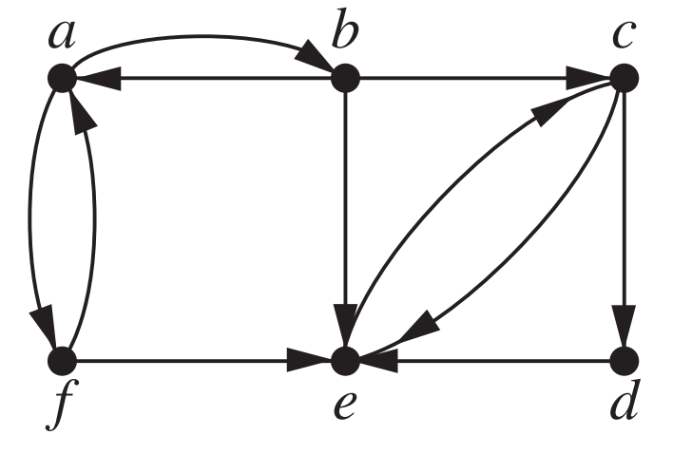
Exercise 1
Is the following graph strongly connected?
If not, find out strongly connected components of this graph:

Slide 51
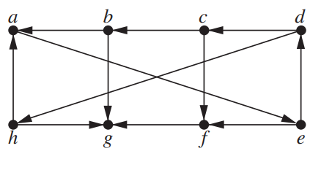
Exercise 2
Find out strongly connected components of this graph:

Slide 52
Graph isomorphism

Slide 53
Graph Isomorphism
A
B
a
c
C
D
d
b
We can draw the same graph differently
If we can determine that two graphs are actually two different representations of the same graph, then they are called isomorphic

Slide 54
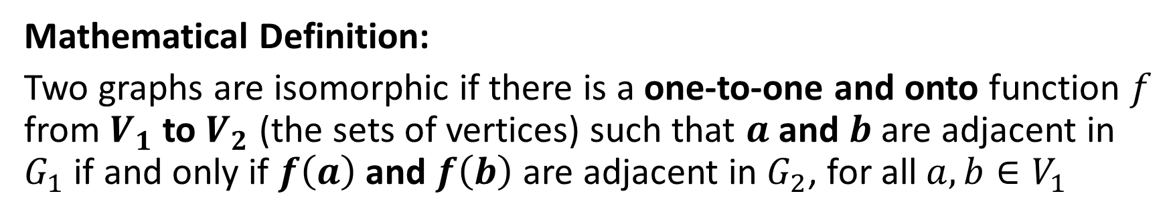
Graph Isomorphism
A
B
a
c
Let’s Break it Down!
C
D
d
b
G1
G2
Mathematical Definition:
Two graphs are isomorphic if there is a one-to-one and onto function $f$ from $V_{1}$ to $V_{2}$ (the sets of vertices) such that $a$ and $b$ are adjacent in $G_{1}$ if and only if $f\left(a\right)$ and $f\left(b\right)$ are adjacent in $G_{2}$, for all $a,b∈V_{1}$

Slide 55
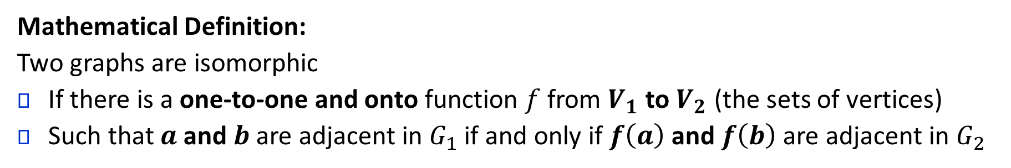
Graph Isomorphism
A
B
C
D
a
b
c
d
A
B
a
c
C
D
d
b
G1
G2
Mathematical Definition:
Two graphs are isomorphic
If there is a one-to-one and onto function $f$ from $V_{1}$ to $V_{2}$ (the sets of vertices)
Such that $a$ and $b$ are adjacent in $G_{1}$ if and only if $f\left(a\right)$ and $f\left(b\right)$ are adjacent in $G_{2}$
This has to be the case for all pairs of vertices
in order for the two graphs to be isomorphic.

Slide 56
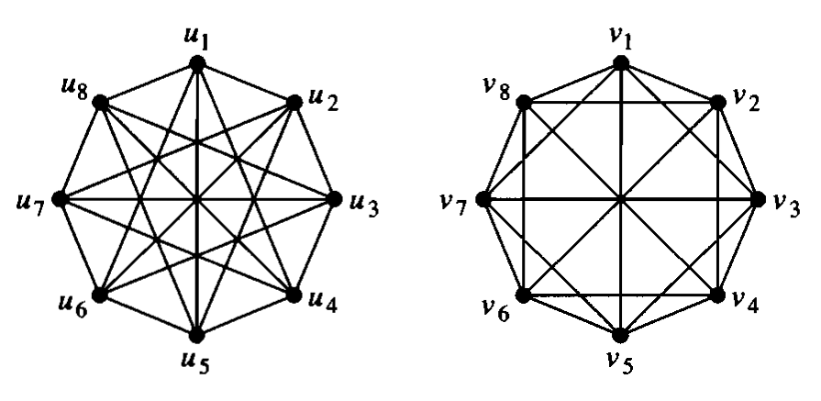
Graph Isomorphism
Are these graphs isomorphic?

Slide 57

Determining isomorphism
Determining isomorphism is a hard problem
$n!$ possible one-to-one correspondences between the vertex sets of two simple graphs with $n$ vertices
But sometimes, you may find signs that can ensure that two graphs are NOT isomorphic

Slide 58
Determining isomorphism
Are these graphs isomorphic?

Slide 59
Disproving isomorphism: Graph invariants
Graph invariants are certain properties of a graph that are preserved by isomorphism.
We can use these to find signs that can ensure that two graphs are NOT isomorphic
Example: number of vertices, number of edges etc.

Slide 60
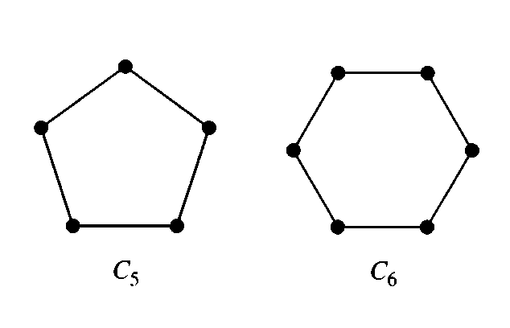
Disproving isomorphism: Graph invariants
Are these graphs isomorphic?
Number of vertices different

Slide 61
Disproving isomorphism: Graph invariants
Are these graphs isomorphic?
Number of edges different

Slide 62
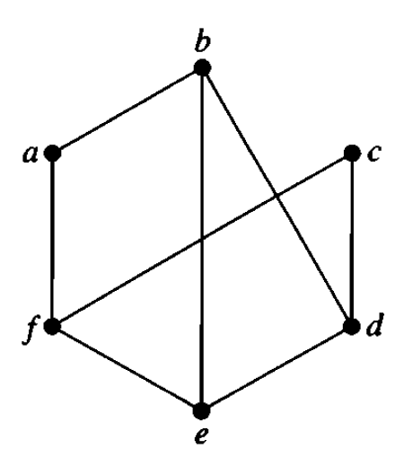
Disproving isomorphism: Graph invariants
Degree Sequence
The degree sequence of a graph is the sequence of the degrees of its vertices in non-increasing order
The degree sequence of the given graph is 3, 3, 3, 3, 2, 2

Slide 63
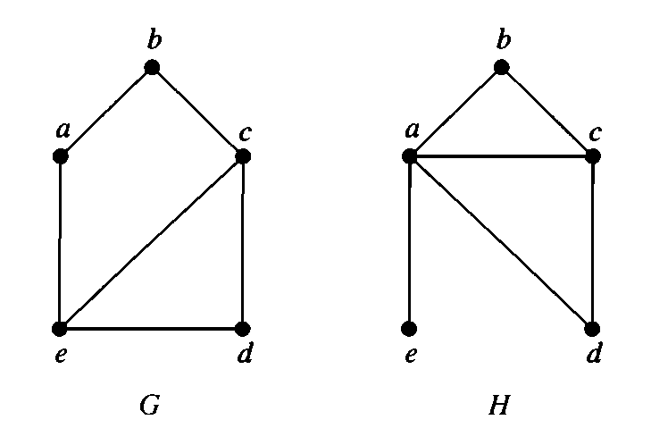
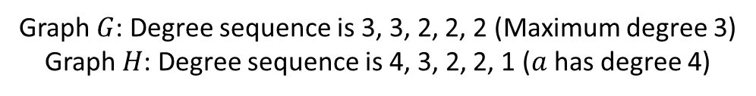
Disproving isomorphism: Graph invariants
Are these graphs isomorphic?
Graph $G$: Degree sequence is 3, 3, 2, 2, 2 (Maximum degree 3)
Graph $H$: Degree sequence is 4, 3, 2, 2, 1 ($a$ has degree 4)

Slide 64
Disproving isomorphism: Graph invariants
Are these graphs isomorphic?
Graph $G$: Degree sequence is 3, 3, 2, 2, 2 (Maximum degree 3)
Graph $H$: Degree sequence is 4, 3, 2, 2, 1 ($a$ has degree 4)

Slide 65
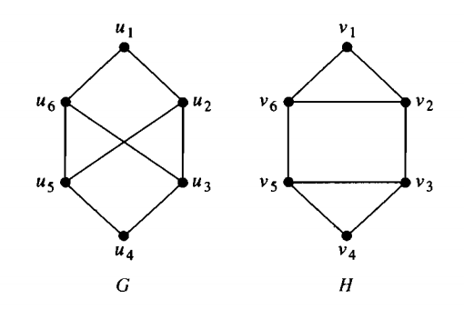

Disproving isomorphism: Graph invariants
Are these graphs isomorphic?
Graph $G$ does not have any simple cycle of length 3 (3 edges).
Graph $H$ has two simple cycles of length 3.

Slide 66
Graph invariants
Graph Invariants Discussed so far:
Number of vertices
Number of edges
Degree sequence
Cycle Length
Adjacency
Did we cover all the graph invariants?
No.
Many more invariants are out there. Many invariants are yet to discover
So even if you see that all the four invariants are same in the two graphs, it does not guarantee isomorphism

Slide 67
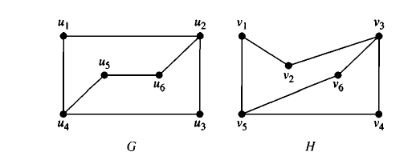
Exercise
A guaranteed way to determine whether these two graphs are isomorphic:
Trying out all possible mapping (May drive you insane!)
Trying out all possible mapping intelligently. (Backtracking)
Recall from the mathematical definition (go back):
If we can show one to and onto mappings such that the adjacency of the corresponding vertices are unchanged
Then we identify the two graphs as isomorphs

Slide 68
Exercise
2
3
2
3
2
2
2
2
3
2
3
2
Backtracking
Find the degrees of the vertices of the two graphs
Try to map the vertices taking into account the degrees of
The vertices being mapped
The neighbors of the vertices being mapped

Slide 69
Thank You

